Slide 1


Italian Restaurants
in New York City
An analysis of distribution and location
Amedeo Amiti, February 2020

Slide 2
KEY QUESTIONS:
How many Italian restaurants are there in New York City?
How are they distributed across the 5 boroughs of New York?
How are they concentrated in relation to population?
Which are the local communities with the highest number of Italian restaurants?

Slide 3
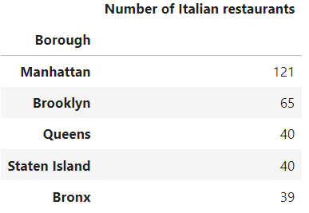
305
The total number of Italian restaurant in New York City is
Manhattan has the highest concentration of restaurants, whereas Bronx has the lowest.

Slide 4
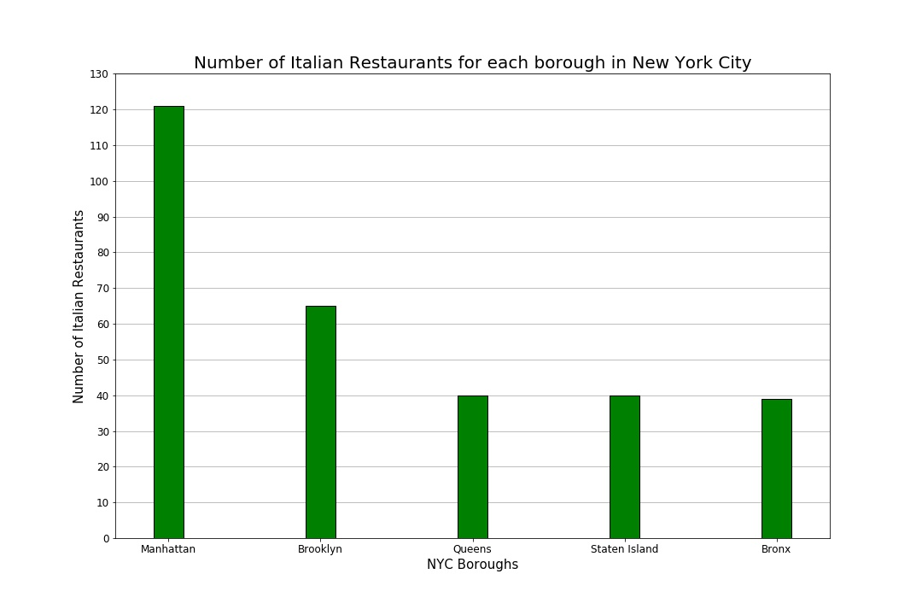

Slide 5
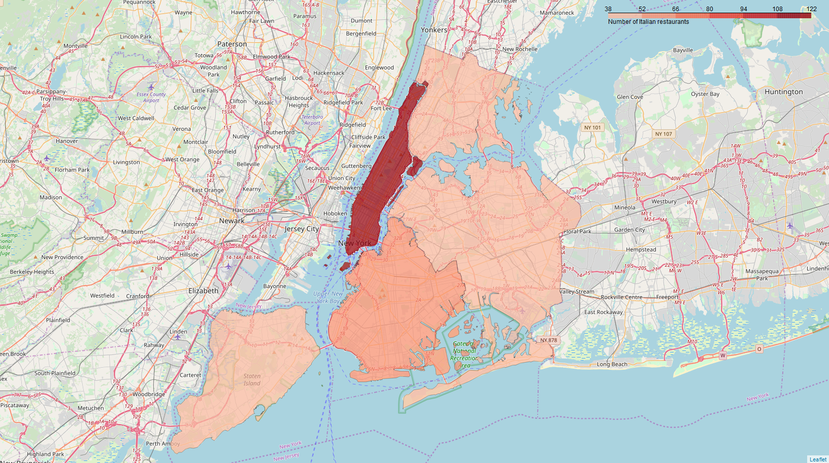
Density of Italian restaurants across New York boroughs

Slide 6
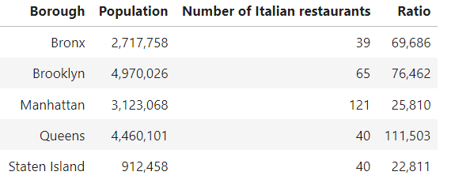
The ratio population/restaurants is a good indicator of distribution as takes into account the local demographics as a catchment area (or “user base”).
Queens has the highest population/Italian restaurants ratio (i.e. there are fewer restaurants in relation to the local population).

Slide 7
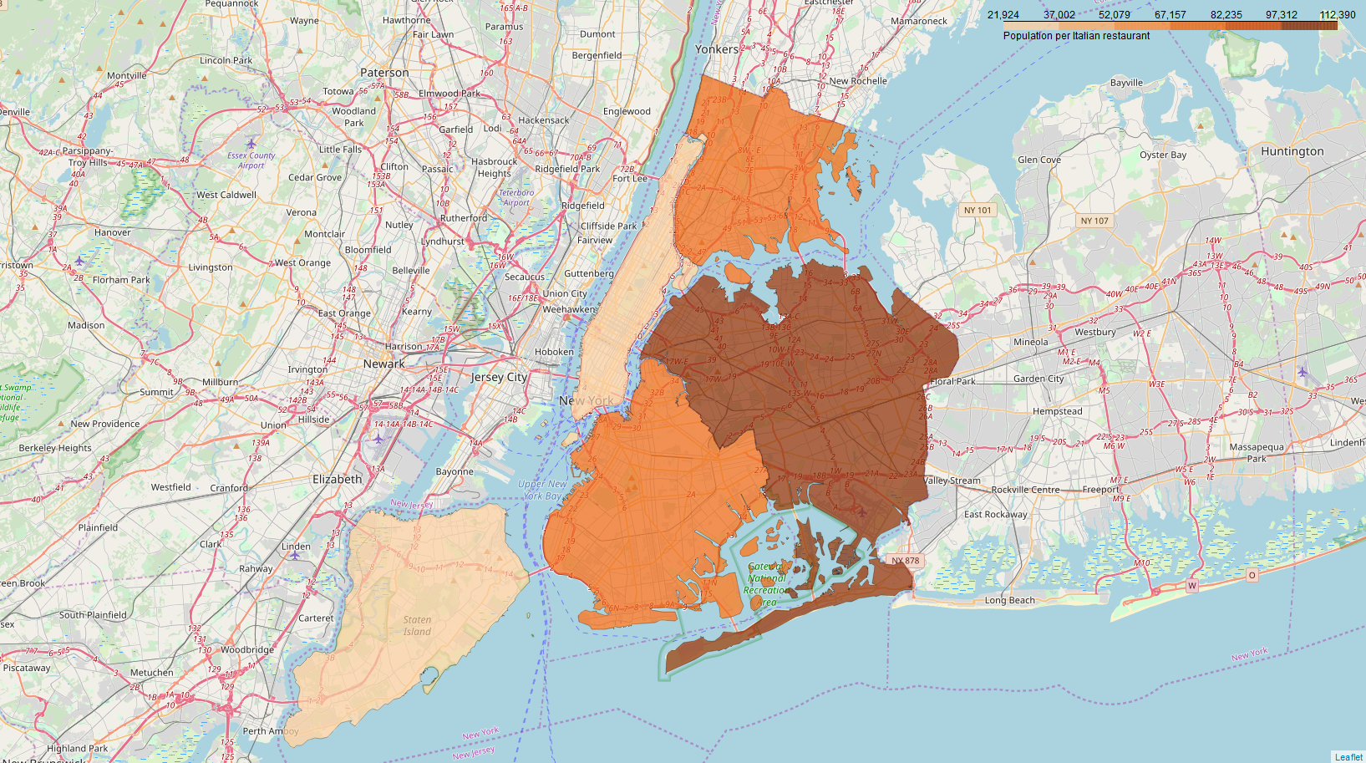
Ratio population/Italian restaurants

Slide 8
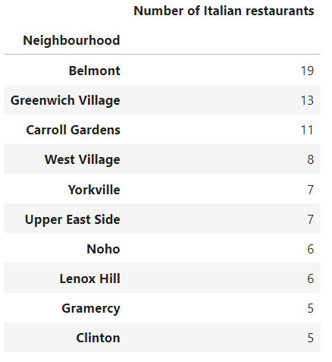
The top 10 neighbourhoods for number of Italian restaurants account for 87 restaurants, that is 28.5% of the overall NYC total.
Most of these neighbourhoods (8 out of 10) are located in Manhattan.

Slide 9
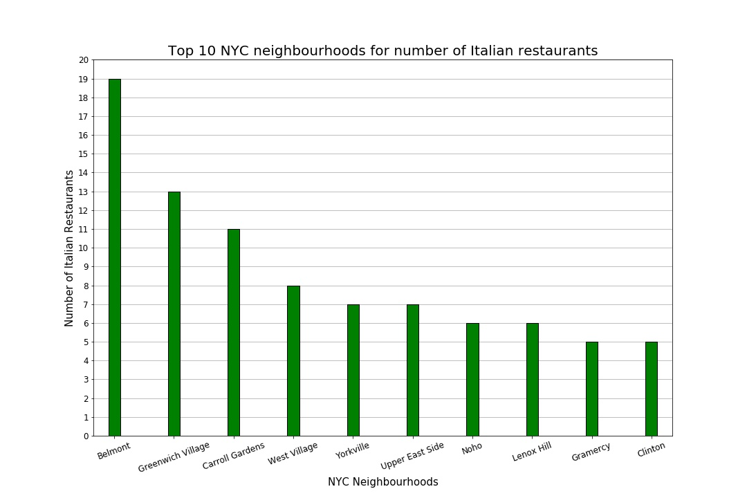

Slide 10
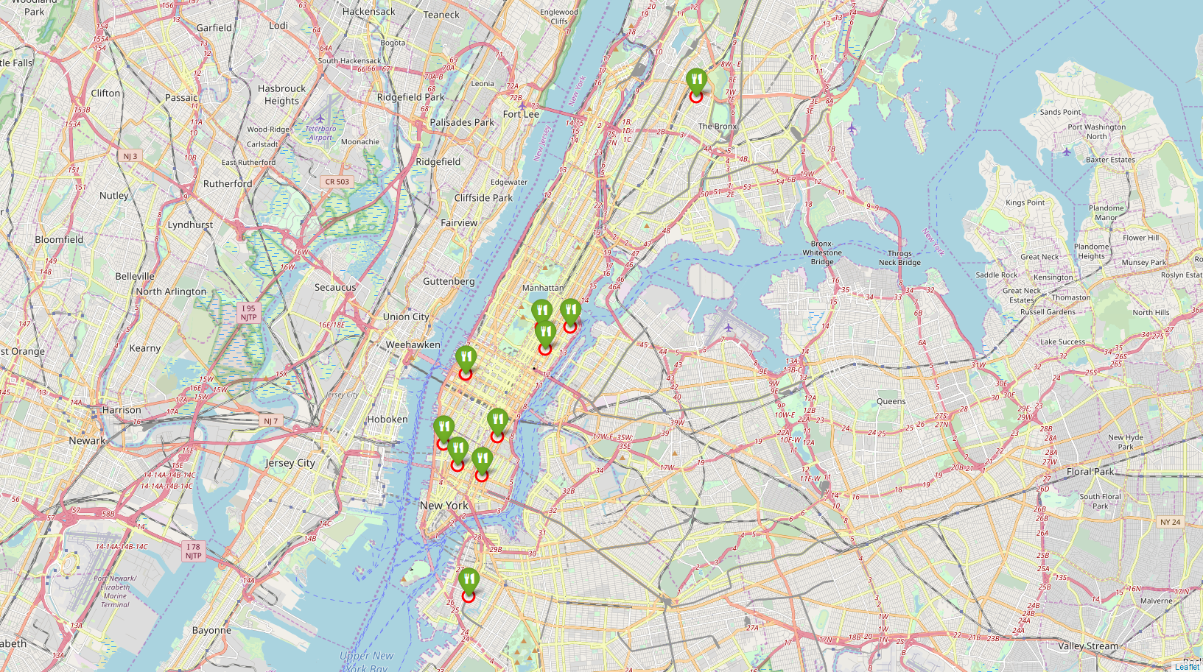
Top 10 communities for number of Italian restaurants

Slide 11
Data sources:
Foursquare
www.foursquare.com
Cognitive Class
https://cocl.us/
NYC OpenData
https://data.cityofnewyork.us/

